Slide 2
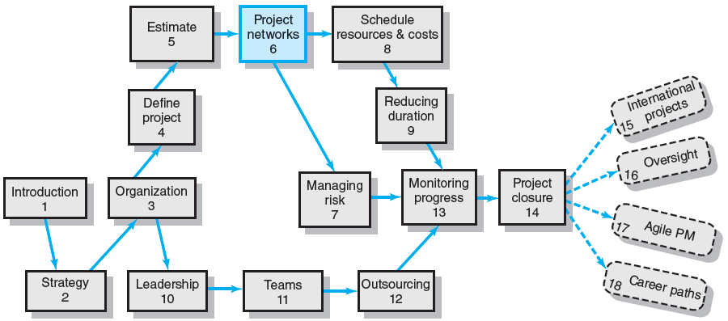
Where We Are Now

Slide 3
I keep six honest serving-men (they taught me all I knew); their names are What and Why and When and How and Where and Who.
Rudyard Kipling

Slide 4
Developing the Project Plan
The Project Network
A flow chart that graphically depicts the sequence, interdependencies, and start and finish times of the project job plan of activities that is the critical path through the network.
Provides the basis for scheduling labor and equipment.
Enhances communication among project participants.
Provides an estimate of the project’s duration.
Provides a basis for budgeting cash flow.
Identifies activities that are critical.
Highlights activities that are “critical” and can not be delayed.
Help managers get and stay on plan.

Slide 5
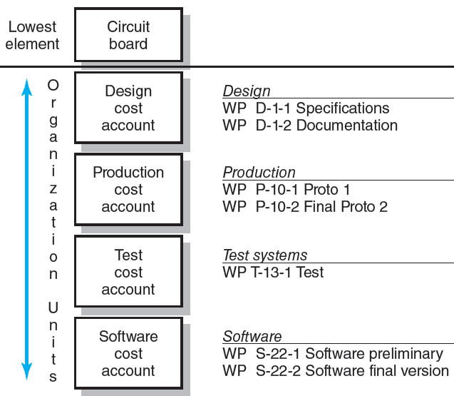
WBS/Work Packages to Network
FIGURE 6.1

Slide 6
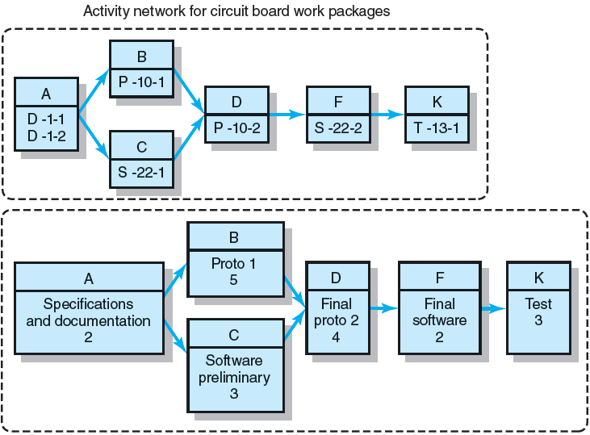
WBS/Work Package to Network (cont’d)
FIGURE 6.1 (cont’d)

Slide 7
Constructing a Project Network
Terminology
Activity: an element of the project that requires time.
Merge Activity: an activity that has two or more preceding activities on which it depends.
Parallel (Concurrent) Activities: Activities that can occur independently and, if desired, not at the same time.
A
B
D
C

Slide 8
Constructing a Project Network (cont’d)
Terminology
Path: a sequence of connected, dependent activities.
Critical path: the longest path through the activity network that allows for the completion of all project-related activities; the shortest expected time in which the entire project can be completed. Delays on the critical path will delay completion of the entire project.
C
A
B
D
(Assumes that minimum of A + B > minimum of C in length of times to complete activities.)

Slide 9
Constructing a Project Network (cont’d)
Terminology
Event: a point in time when an activity is started or completed. It does not consume time.
Burst Activity: an activity that has more than one activity immediately following it (more than one dependency arrow flowing from it).
Two Approaches
Activity-on-Node (AON)
Uses a node to depict an activity.
Activity-on-Arrow (AOA)
Uses an arrow to depict an activity.
B
A
C
D

Slide 10
Basic Rules to Follow in Developing Project Networks
Networks typically flow from left to right.
An activity cannot begin until all preceding connected activities are complete.
Arrows indicate precedence and flow and can cross over each other.
Each activity must have a unique identify number that is greater than any of its predecessor activities.
Looping is not allowed.
Conditional statements are not allowed.
Use common start and stop nodes.

Slide 11
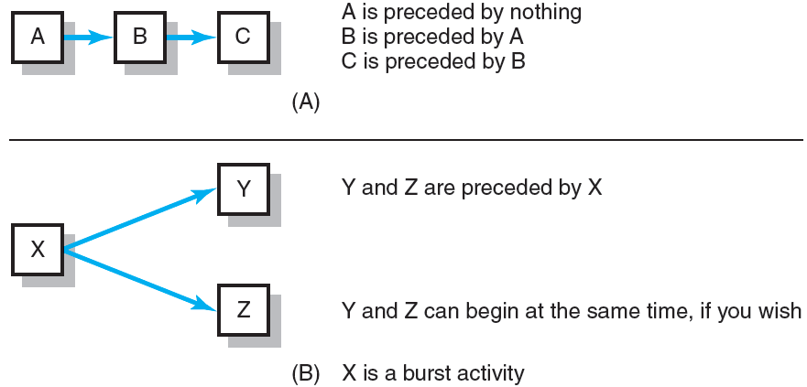
Activity-on-Node Fundamentals
FIGURE 6.2

Slide 12
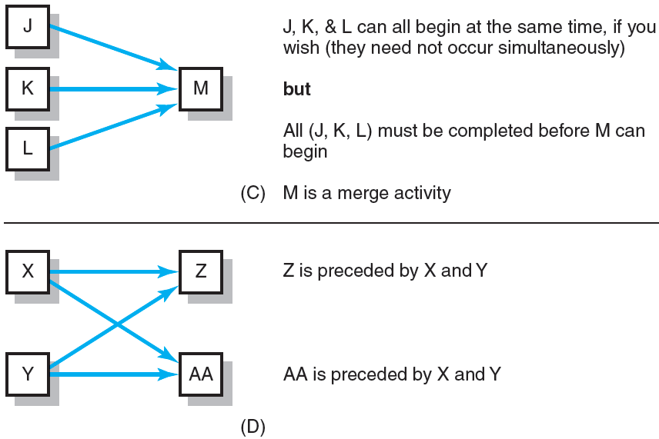
Activity-on-Node Fundamentals (cont’d)
FIGURE 6.2 (cont’d)

Slide 13
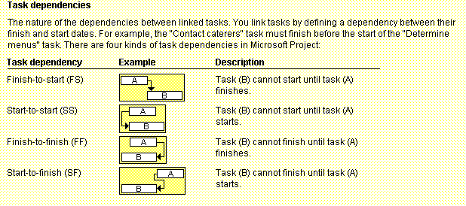
Figure 6-3. Task Dependency Types
Managing Information Technology Projects, Sixth Edition
Schwalbe

Slide 14
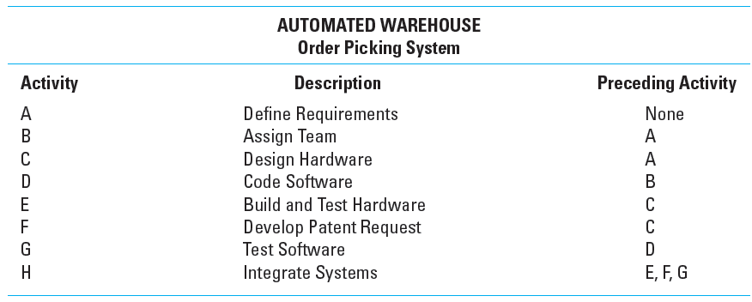
Network Information
TABLE 6.1

Slide 15
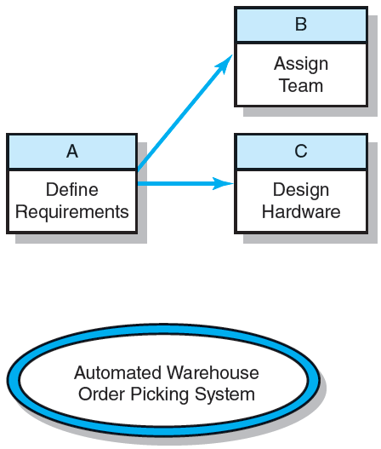
Automate Warehouse—Partial Network
FIGURE 6.3

Slide 16
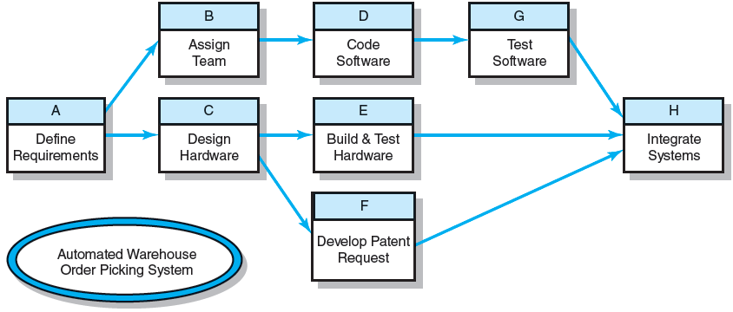
Automated Warehouse—Complete Network
FIGURE 6.4

Slide 17
Network Computation Process
Forward Pass—Earliest Times
How soon can the activity start? (early start—ES)
How soon can the activity finish? (early finish—EF)
How soon can the project finish? (expected time—ET)
Backward Pass—Latest Times
How late can the activity start? (late start—LS)
How late can the activity finish? (late finish—LF)
Which activities represent the critical path?
How long can activity be delayed? (slack or float—SL)

Slide 18
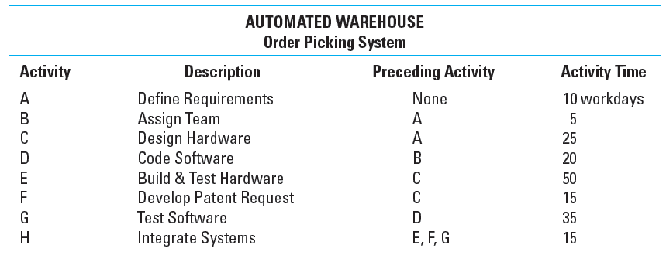
Network Information
TABLE 6.2

Slide 19
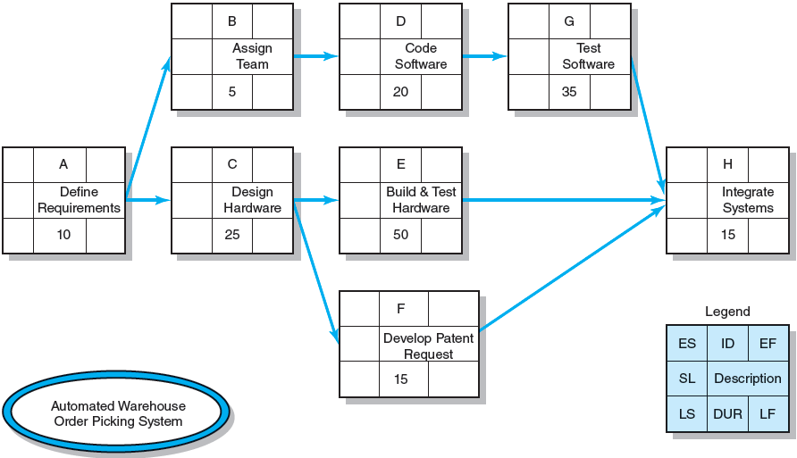
Activity-on-Node Network
FIGURE 6.5

Slide 20
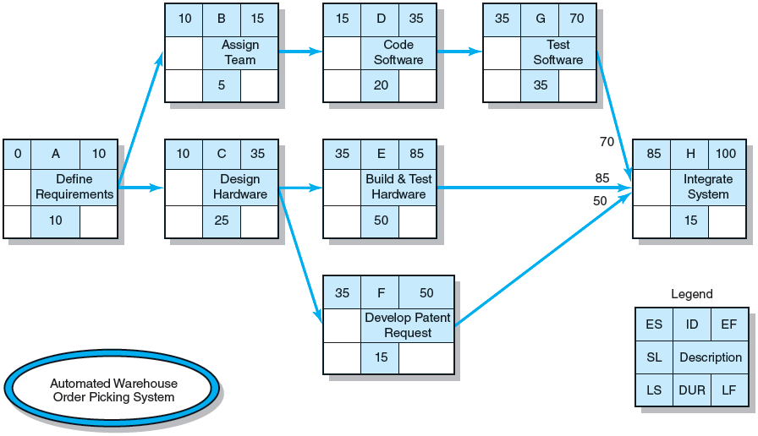
Activity-on-Node Network Forward Pass
FIGURE 6.6

Slide 21
Forward Pass Computation
Add activity times along each path in the network (ES + Duration = EF).
Carry the early finish (EF) to the next activity where it becomes its early start (ES) unless…
The next succeeding activity is a merge activity, in which case the largest EF of all preceding activities is selected.

Slide 22
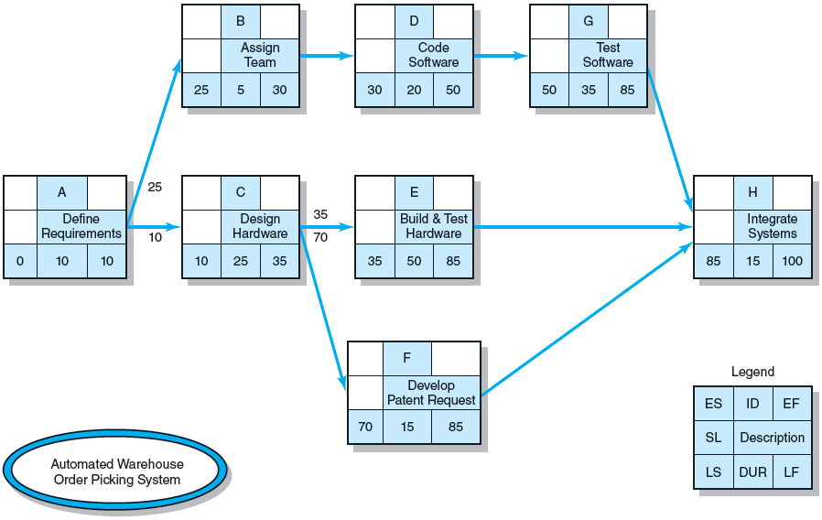
Activity-on-Node Network Backward Pass
FIGURE 6.7

Slide 23
Backward Pass Computation
Subtract activity times along each path in the network (LF - Duration = LS).
Carry the late start (LS) to the next activity where it becomes its late finish (LF) unless
The next succeeding activity is a burst activity, in which case the smallest LF of all preceding activities is selected.

Slide 24
Determining Free Slack (or Float)
Free Slack (or Float)
Is the amount of time an activity can be delayed after the start of a longer parallel activity or activities.
Is how long an activity can exceed its early finish date without affecting early start dates of any successor(s).
Allows flexibility in scheduling scarce resources.
Sensitivity
The likelihood the original critical path(s) will change once the project is initiated.
The critical path is the network path(s) that has (have) the least slack in common.

Slide 25
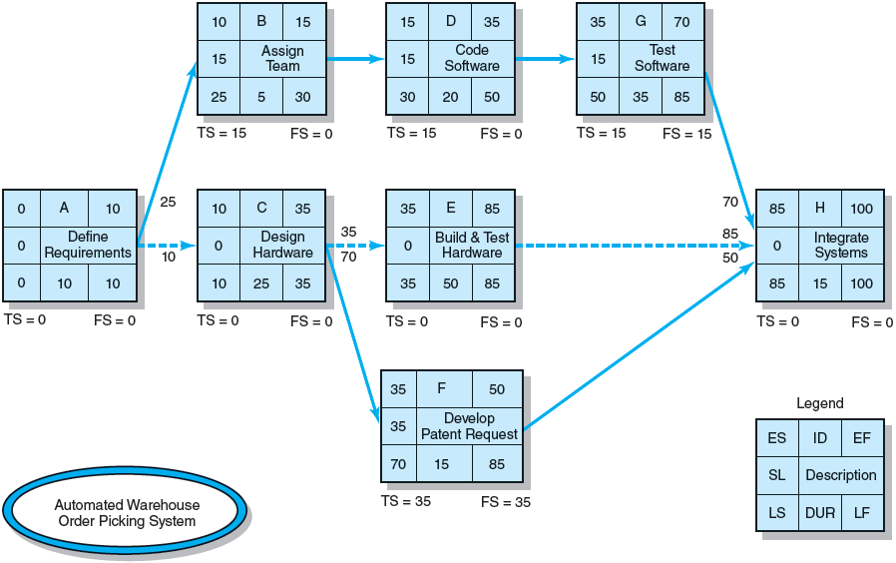
Forward and Backward Passes Completed with Slack Times
FIGURE 6.8

Slide 26
Practical Considerations
Network Logic Errors
Activity Numbering
Use of Computers to Develop Networks
Calendar Dates
Multiple Starts and Multiple Projects

Slide 27
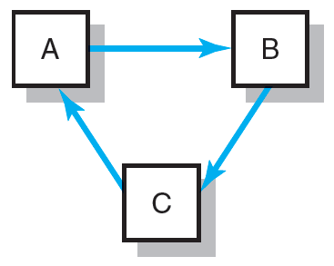
Network Logic Errors: Illogical Loop
FIGURE 6.9

Slide 28
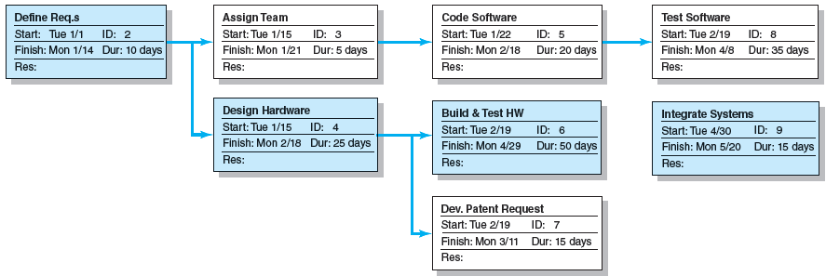
Automated Warehouse Order Picking System Network
FIGURE 6.10

Slide 29
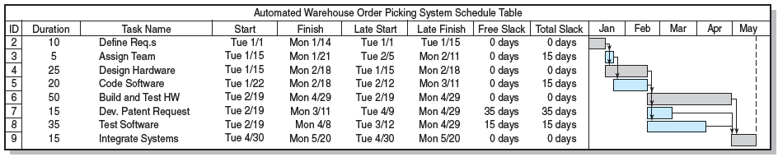
Automated Order Warehouse Picking System Bar Chart
FIGURE 6.11

Slide 30
Extended Network Techniques to Come Close to Reality
Laddering
Activities are broken into segments so the following activity can begin sooner and not delay the work.
Lags
The minimum amount of time a dependent activity must be delayed to begin or end.
Lengthy activities are broken down to reduce the delay in the start of successor activities.
Lags can be used to constrain finish-to-start, start-to-start, finish-to-finish, start-to-finish, or combination relationships.

Slide 31
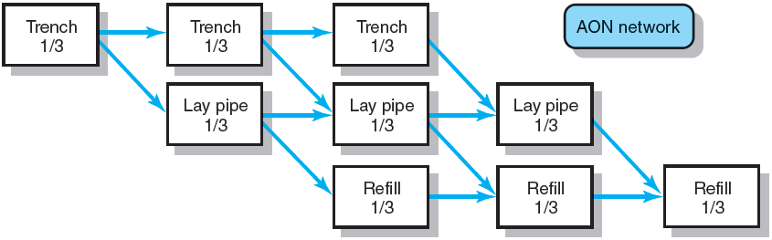
Example of Laddering Using Finish-to-Start Relationship
FIGURE 6.12

Slide 32

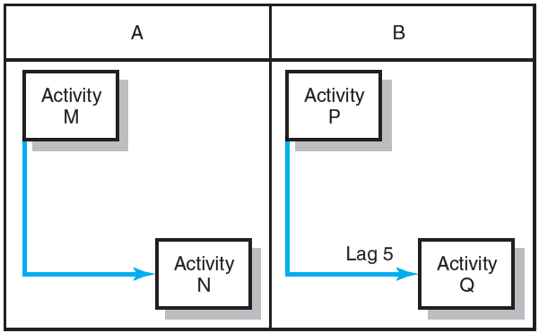
Use of Lags
Finish-to-Start Relationship
FIGURE 6.13
Start-to-Start Relationship
FIGURE 6.14

Slide 33
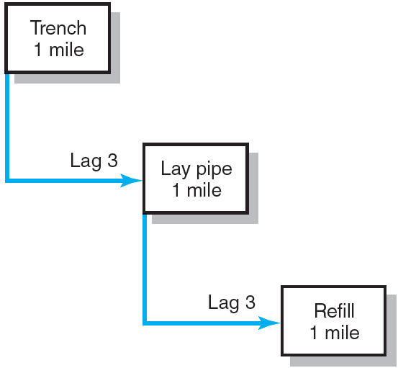
Use of Lags Cont’d
Use of Lags to Reduce Project Duration
FIGURE 6.15

Slide 34
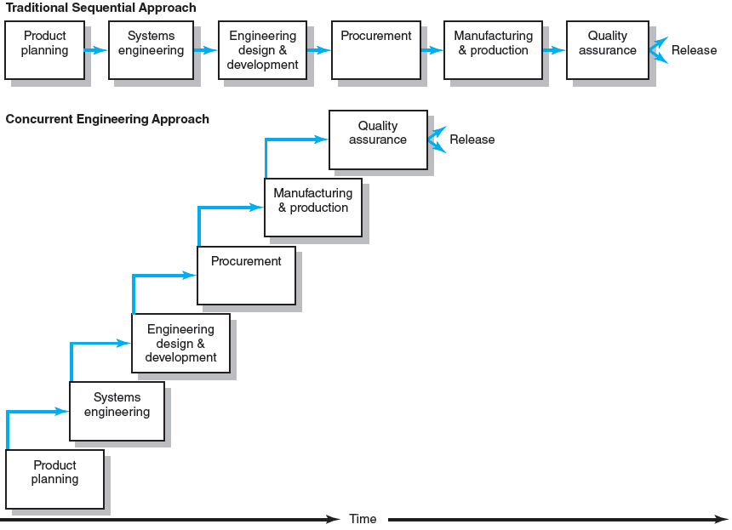
New Product Development Process
FIGURE 6.16

Slide 35
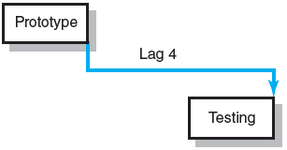
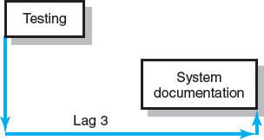
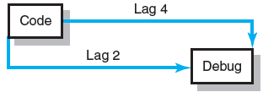
Use of Lags (cont’d)
Finish-to-Finish Relationship
FIGURE 6.17
Start-to-Finish Relationship
FIGURE 6.18
Combination Relationship
FIGURE 6.19

Slide 36
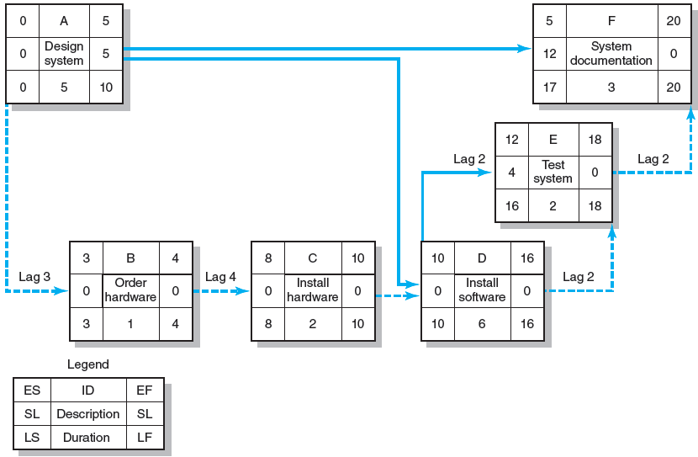
Network Using Lags
FIGURE 6.20

Slide 37
Hammock Activities
Hammock Activity
Spans over a segment of a project.
Has a duration that is determined after the network plan is drawn.
Is used to aggregate sections of the project to facilitate getting the right amount of detail for specific sections of a project.
Is very useful in assigning and controlling indirect project costs.

Slide 38
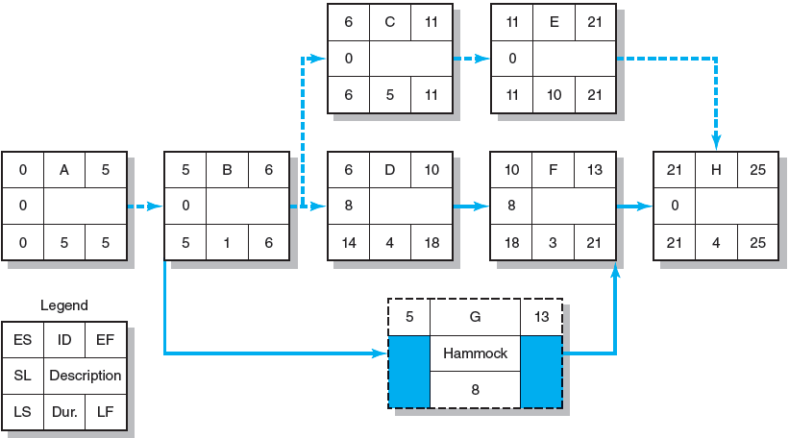
Hammock Activity Example
FIGURE 6.21

Slide 39
Key Terms
Activity
Activity-on-arrow (AOA)
Activity-on-node (AON)
Burst activity
Concurrent engineering
Critical path
Early and late times
Free slack
Gantt chart
Hammock activity
Lag relationship
Merge activity
Parallel activity
Sensitivity
Total slack

Slide 40
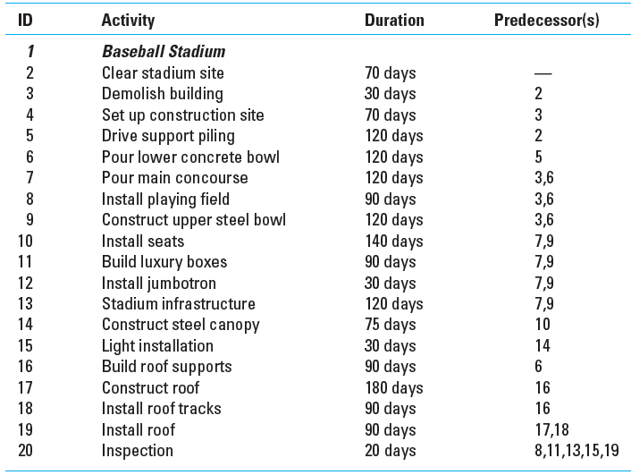
Greendale Stadium Case
TABLE 6.3

